Slide 1
User Control Structure

Slide 2
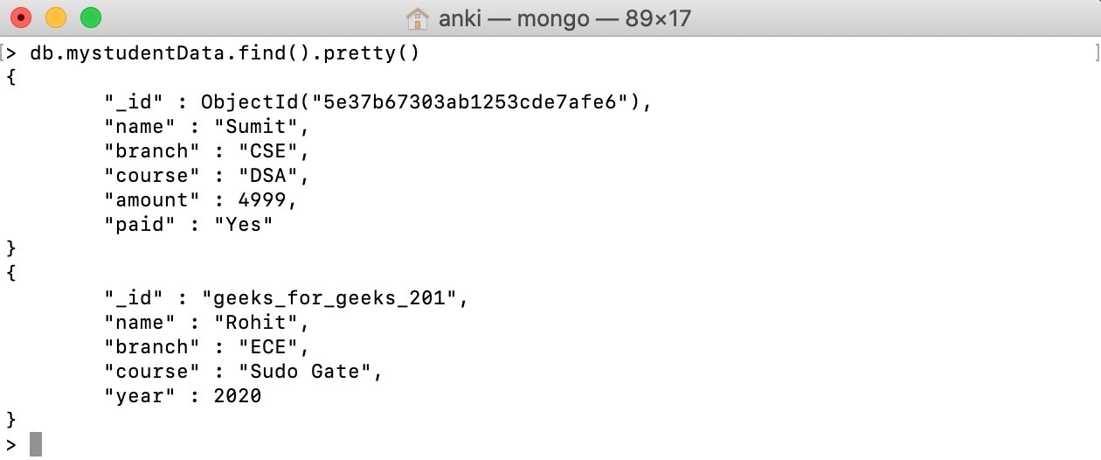
MERN
MongoDB
Express
React
Node JS Node, it’s an open-source, cross-platform runtime environment that allows developers to create various server-side tools and applications using JavaScript.

Slide 3



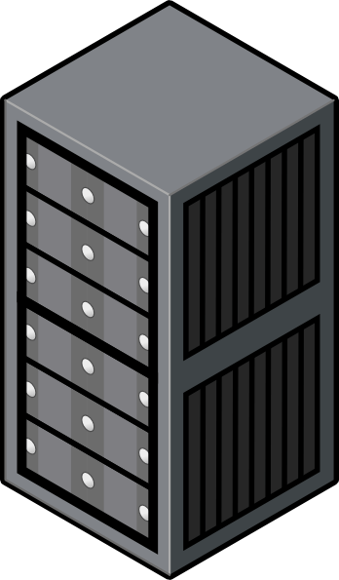

LAYOUT
API
ACCESS
LEVEL

Slide 4
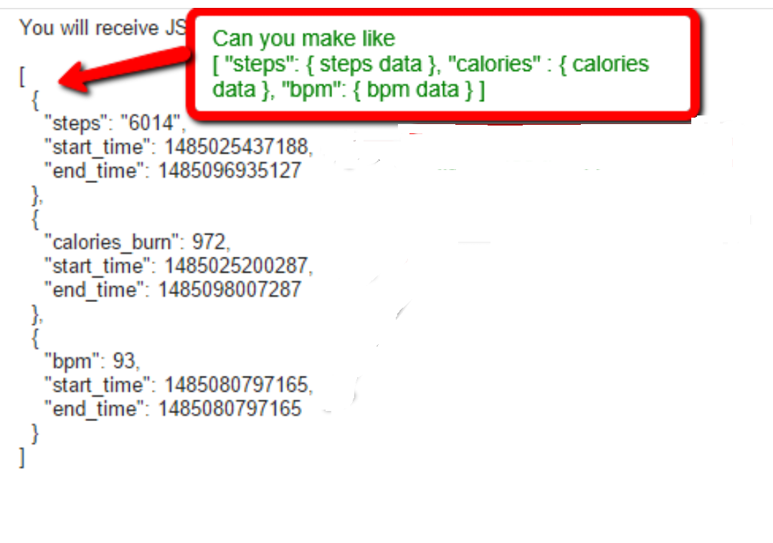
JSON

